Slide 1
MODULE-IV
Module IV | SOFTWARE TESTING STRATEGIES AND APPLICATIONS | (09Period)
Testing strategies: A strategic approach to software testing, Strategic issues, Test strategies for conventional software, Test strategies for object oriented software, Validation testing, System testing, The art of debugging. Testing Conventional Applications: Software testing fundamentals, White box testing-Basis path testing, Control structure testing; Black box testing, Object oriented testing methods

Slide 2
A STRATEGIC APPROACH TO SOFTWARE TESTING
Software Testing is a type of investigation to find out if there is any default or error present in the software so that the errors can be reduced or removed to increase the quality of the software and to check whether it fulfills the specifies requirements or not.
The process of investigating and checking a program to find whether there is an error or not and does it fulfill the requirements or not is called testing.
When the number of errors found during the testing is high, it indicates that the testing was good and is a sign of good test case.
Finding an unknown error that’s wasn’t discovered yet is a sign of a successful and a good test case.
The main objective of software testing is to design the tests in such a way that it systematically finds different types of errors without taking much time and effort so that less time is required for the development of the software.

Slide 3
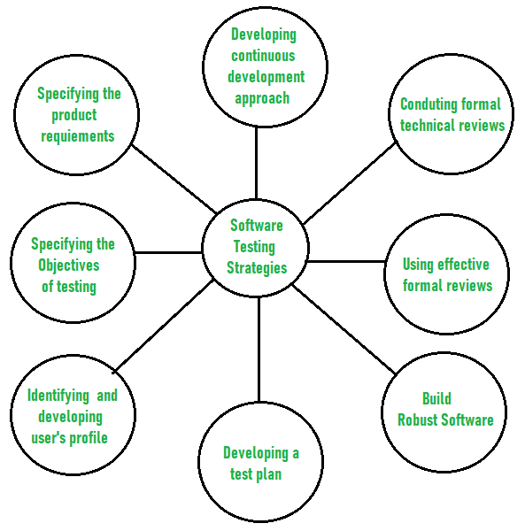
A STRATEGIC APPROACH TO SOFTWARE TESTING

Slide 4
A STRATEGIC APPROACH TO SOFTWARE TESTING
Specifying the objectives of testing in a clear and detailed manner.
Several objectives of testing are there such as effectiveness that means how effectively the software can achieve the target, any failure that means inability to fulfill the requirements and perform functions, and the cost of defects or errors that mean the cost required to fix the error. All these objectives should be clearly mentioned in the test plan.
For the software, identifying the user’s category and developing a profile for each user.
Use cases describe the interactions and communication among different classes of users and the system to achieve the target. So as to identify the actual requirement of the users and then testing the actual use of the product.

Slide 5
A STRATEGIC APPROACH TO SOFTWARE TESTING
Developing a test plan to give value and focus on rapid-cycle testing.
Rapid Cycle Testing is a type of test that improves quality by identifying and measuring the any changes that need to be required for improving the process of software. Therefore, a test plan is an important and effective document that helps the tester to perform rapid cycle testing.
Robust software is developed that is designed to test itself.
The software should be capable of detecting or identifying different classes of errors. Moreover, software design should allow automated and regression testing which tests the software to find out if there is any adverse or side effect on the features of software due to any change in code or program.

Slide 6
A STRATEGIC APPROACH TO SOFTWARE TESTING
Before testing, using effective formal reviews as a filter.
Formal technical reviews is technique to identify the errors that are not discovered yet. The effective technical reviews conducted before testing reduces a significant amount of testing efforts and time duration required for testing software so that the overall development time of software is reduced.
Conduct formal technical reviews to evaluate the nature, quality or ability of the test strategy and test cases.
The formal technical review helps in detecting any unfilled gap in the testing approach. Hence, it is necessary to evaluate the ability and quality of the test strategy and test cases by technical reviewers to improve the quality of software.

Slide 7
A STRATEGIC APPROACH TO SOFTWARE TESTING
For the testing process, developing a approach for the continuous development.
As a part of a statistical process control approach, a test strategy that is already measured should be used for software testing to measure and control the quality during the development of software.

Slide 8
A STRATEGIC ISSUES
Following are the four strategies for conventional software: 1) Unit testing 2) Integration testing 3) Regression testing 4) Smoke testing
1) Unit testing
Unit testing focus on the smallest unit of software design, i.e module or software component.
Test strategy conducted on each module interface to access the flow of input and output.
The local data structure is accessible to verify integrity during execution.

Slide 9
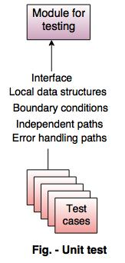
A STRATEGIC ISSUES

Slide 10
A STRATEGIC ISSUES
2) Integration testing
Integration testing is used for the construction of software architecture. There are two approaches of incremental testing are: i) Non incremental integration testing ii) Incremental integration testing i) Non incremental integration testing
Combines all the components in advanced.
A set of error is occurred then the correction is difficult because isolation cause is complex.
ii) Incremental integration testing
The programs are built and tested in small increments.
The errors are easier to correct and isolate.

Slide 11
A STRATEGIC ISSUES
Following are the incremental integration strategies: a. Top-down integration b. Bottom-up integration
a. Top-down integration
It is an incremental approach for building the software architecture.
It starts with the main control module or program.
Modules are merged by moving downward through the control hierarchy.

Slide 12
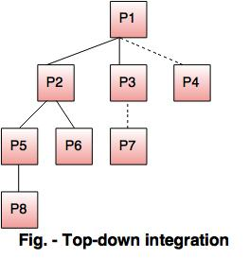
A STRATEGIC ISSUES

Slide 13
A STRATEGIC ISSUES
Problems with top-down approach of testing are
Top-down approach is an incremental integration testing approach in which the test conditions are difficult to create.
A set of errors occur, then correction is difficult to make due to the isolation of cause.
The programs are expanded into various modules due to the complications.
If the previous errors are corrected, then new get created and the process continues. This situation is like an infinite loop.

Slide 14
A STRATEGIC ISSUES
b. Bottom-up integration
In bottom up integration testing the components are combined from the lowest level in the program structure. The bottom-up integration is implemented in following steps:
The low level components are merged into clusters which perform a specific software sub function.
A control program for testing(driver) coordinate test case input and output.
After these steps are tested in cluster.
The driver is removed and clusters are merged by moving upward on the program structure.

Slide 15
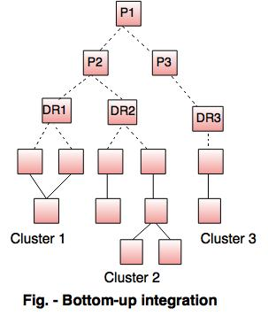
A STRATEGIC ISSUES

Slide 16
A STRATEGIC ISSUES
3) Regression testing
In regression testing the software architecture changes every time when a new module is added as part of integration testing.
4) Smoke testing
The developed software component are translated into code and merge to complete the product.

Slide 17
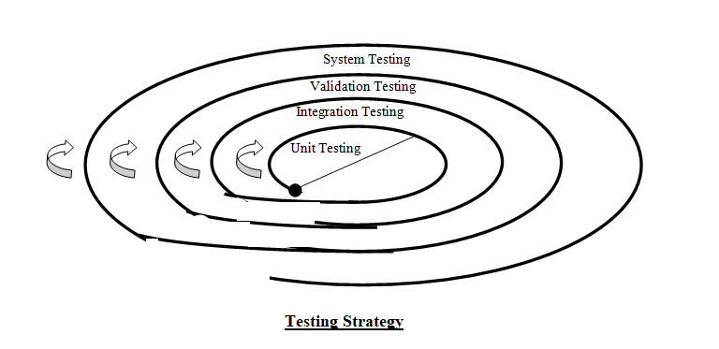
A TEST STRATEGY FOR CONVENTIONAL SOFTWARE

Slide 18
A TEST STRATEGY FOR CONVENTIONAL SOFTWARE
Unit testing starts at the middle of the spiral and concentrates on the software's components as they are written in the source code.
Proceeding in a different direction down the spiral, we encounter integration testing, which is concerned with the planning and building of software architecture.
Next, validation testing is introduced, which compares requirements that have been established during software requirements analysis with software that has already been developed.
Finally, we come across verification testing, which verifies that software that has been constructed satisfies requirements that were determined during software requirements

Slide 19
A TEST STRATEGY FOR CONVENTIONAL SOFTWARE
There are many different ways to test software, thus some of the available options are as follows:
(i) A software team could wait until the system is completely built, and then they could run tests on the system to look for faults. This strategy is not effective in the majority of situations.
(ii) A software engineer might be able to run tests every day anytime any component of the system is being built . This strategy has the potential to yield excellent results. But the majority of software engineers are reluctant to make use of it
(iii) The majority of software teams opt for a testing technique that lies somewhere in the middle of the two extremes

Slide 20
A TEST STRATEGY FOR OBJECT ORIENTED SOFTWARE
Techniques of object-oriented testing are as follows:
Fault Based Testing:
This type of checking permits for coming up with test cases supported the consumer specification or the code or both. It tries to identify possible faults. For all of these faults, a test case is developed to “flush” the errors out. These tests also force each time of code to be executed.
This method of testing does not find all types of errors. However, incorrect specification and interface errors can be missed.
These types of errors can be uncovered by function testing in the traditional testing model. In the object-oriented model, interaction errors can be uncovered by scenario-based testing.
This form of Object oriented-testing can only test against the client’s specifications, so interface errors are still missed.

Slide 21
A TEST STRATEGY FOR OBJECT ORIENTED SOFTWARE
Class Testing Based on Method Testing:
This approach is the simplest approach to test classes. Each method of the class performs a well defined cohesive function and can, therefore, be related to unit testing of the traditional testing techniques. Therefore all the methods of a class can be involved at least once to test the class.
Random Testing:
It is supported by developing a random test sequence that tries the minimum variety of operations typical to the behavior of the categories

Slide 22
A TEST STRATEGY FOR OBJECT ORIENTED SOFTWARE
Partition Testing:
This methodology categorizes the inputs and outputs of a category so as to check them severely. This minimizes the number of cases that have to be designed.
Scenario-based Testing:
It primarily involves capturing the user actions then stimulating them to similar actions throughout the test.

Slide 23
VALIDATION TESTING
The process of evaluating software during the development process or at the end of the development process to determine whether it satisfies specified business requirements.
Validation Testing ensures that the product actually meets the client's needs. It can also be defined as to demonstrate that the product fulfills its intended use when deployed on appropriate environment. Validation testing can be best demonstrated using V-Model.
The Software/product under test is evaluated during this type of testing.

Slide 24
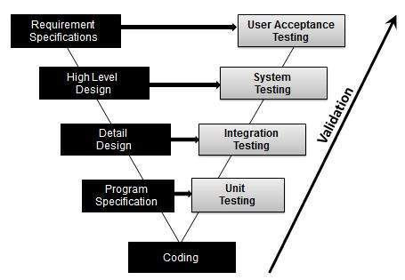
VALIDATION TESTING

Slide 25
SYSTEM TESTING
System Testing is a type of software testing that is performed on a complete integrated system to evaluate the compliance of the system with the corresponding requirements. In system testing, integration testing passed components are taken as input.
System testing detects defects within both the integrated units and the whole system.
The result of system testing is the observed behavior of a component or a system when it is tested. System Testing is carried out on the whole system in the context of either system requirement specifications or functional requirement specifications or in the context of both.

Slide 26
SYSTEM TESTING
System testing tests the design and behavior of the system and also the expectations of the customer. It is performed to test the system beyond the bounds mentioned in the software requirements specification (SRS).
System Testing is basically performed by a testing team that is independent of the development team that helps to test the quality of the system impartial.
It has both functional and non-functional testing. System Testing is a black-box testing. System Testing is performed after the integration testing and before the acceptance testing.

Slide 27
SYSTEM TESTING
System Testing Process: System Testing is performed in the following steps:
Test Environment Setup: Create testing environment for the better quality testing.
Create Test Case: Generate test case for the testing process.
Create Test Data: Generate the data that is to be tested.
Execute Test Case: After the generation of the test case and the test data, test cases are executed.
Defect Reporting: Defects in the system are detected.
Regression Testing: It is carried out to test the side effects of the testing process.
Log Defects: Defects are fixed in this step.
Retest: If the test is not successful then again test is performed.

Slide 28
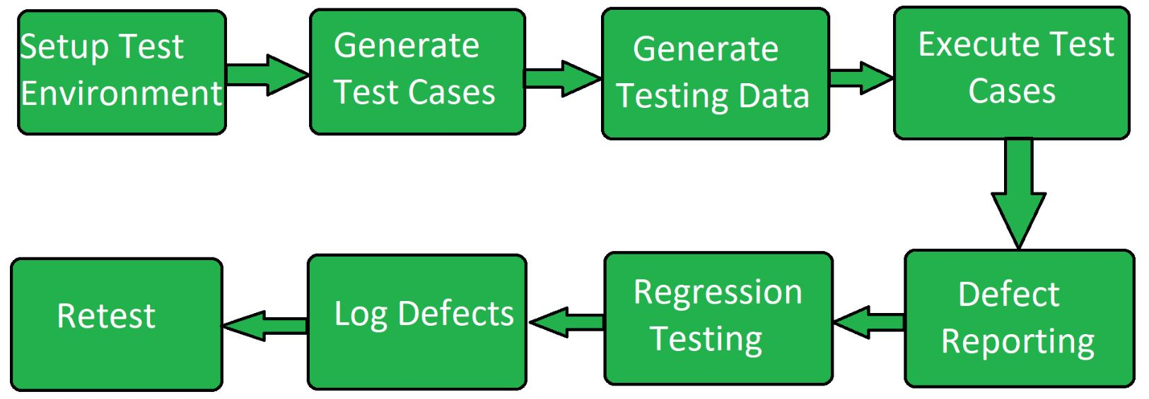
SYSTEM TESTING

Slide 29
SYSTEM TESTING
Types of System Testing:
Performance Testing: Performance Testing is a type of software testing that is carried out to test the speed, scalability, stability and reliability of the software product or application.
Load Testing: Load Testing is a type of software Testing which is carried out to determine the behavior of a system or software product under extreme load.
Stress Testing: Stress Testing is a type of software testing performed to check the robustness of the system under the varying loads.
Scalability Testing: Scalability Testing is a type of software testing which is carried out to check the performance of a software application or system in terms of its capability to scale up or scale down the number of user request load.

Slide 30
SYSTEM TESTING
Advantages of System Testing :
The testers do not require more knowledge of programming to carry out this testing.
It will test the entire product or software so that we will easily detect the errors or defects which cannot be identified during the unit testing and integration testing.
The testing environment is similar to that of the real time production or business environment.
It checks the entire functionality of the system with different test scripts and also it covers the technical and business requirements of clients.
After this testing, the product will almost cover all the possible bugs or errors and hence the development team will confidently go ahead with acceptance testing.

Slide 31
SYSTEM TESTING
Disadvantages of System Testing :
This testing is time consuming process than another testing techniques since it checks the entire product or software.
The cost for the testing will be high since it covers the testing of entire software.
It needs good debugging tool otherwise the hidden errors will not be found.

Slide 32
THE ART OF DEBUGGING
Debugging is the process of fixing a bug in the software. In other words, it refers to identifying, analyzing, and removing errors.
Debugging Approaches/Strategies:
Brute Force: Study the system for a larger duration in order to understand the system. It helps the debugger to construct different representations of systems to be debugging depending on the need.
Backtracking: Backward analysis of the problem which involves tracing the program backward from the location of the failure message in order to identify the region of faulty code. A detailed study of the region is conducted to find the cause of defects.

Slide 33
THE ART OF DEBUGGING
Cause elimination: it introduces the concept of binary partitioning. Data related to the error occurrence are organized to isolate potential causes.
Debugging Tools:
Debugging tool is a computer program that is used to test and debug other programs. A lot of public domain software like gdb and dbx are available for debugging.
They offer console-based command-line interfaces. Examples of automated debugging tools include code based tracers, profilers, interpreters, etc.
Some of the widely used debuggers are:
Radare2
WinDbg
Valgrind

Slide 34
SOFTWARE TESTING FUNDAMENTALS
SOFTWARE TESTING Fundamentals (STF) is a platform to gain (or refresh) basic knowledge in the field of Software Testing.
Software testing can be stated as the process of verifying and validating whether a software or application is bug-free, meets the technical requirements as guided by its design and development, and meets the user requirements effectively and efficiently by handling all the exceptional and boundary cases.
The process of software testing aims not only at finding faults in the existing software but also at finding measures to improve the software in terms of efficiency, accuracy, and usability.
It mainly aims at measuring the specification, functionality, and performance of a software program or application.

Slide 35
SOFTWARE TESTING FUNDAMENTALS
Software testing can be divided into two steps:
Verification: it refers to the set of tasks that ensure that the software correctly implements a specific function.
2. Validation: it refers to a different set of tasks that ensure that the software that has been built is traceable to customer requirements.
Verification: “Are we building the product right?”
Validation: “Are we building the right product?”

Slide 36
SOFTWARE TESTING FUNDAMENTALS
Software Testing can be broadly classified into two types:
1. Manual Testing: Manual testing includes testing software manually, i.e., without using any automation tool or any script. In this type, the tester takes over the role of an end-user and tests the software to identify any unexpected behavior or bug. There are different stages for manual testing such as unit testing, integration testing, system testing, and user acceptance testing.
2. Automation Testing: Automation testing, which is also known as Test Automation, is when the tester writes scripts and uses another software to test the product. This process involves the automation of a manual process. Automation Testing is used to re-run the test scenarios quickly and repeatedly, that were performed manually in manual testing.

Slide 37
SOFTWARE TESTING FUNDAMENTALS
Software testing techniques can be majorly classified into two categories:
Black Box Testing: The technique of testing in which the tester doesn’t have access to the source code of the software and is conducted at the software interface without any concern with the internal logical structure of the software is known as black-box testing.
White-Box Testing: The technique of testing in which the tester is aware of the internal workings of the product, has access to its source code, and is conducted by making sure that all internal operations are performed according to the specifications is known as white box testing.

Slide 38
SOFTWARE TESTING FUNDAMENTALS
Software level testing can be majorly classified into 4 levels:
1. Unit Testing: A level of the software testing process where individual units/components of a software/system are tested. The purpose is to validate that each unit of the software performs as designed.
2. Integration Testing: A level of the software testing process where individual units are combined and tested as a group. The purpose of this level of testing is to expose faults in the interaction between integrated units.
3. System Testing: A level of the software testing process where a complete, integrated system/software is tested. The purpose of this test is to evaluate the system’s compliance with the specified requirements.
4. Acceptance Testing: A level of the software testing process where a system is tested for acceptability. The purpose of this test is to evaluate the system’s compliance with the business requirements and assess whether it is acceptable for delivery.

Slide 39
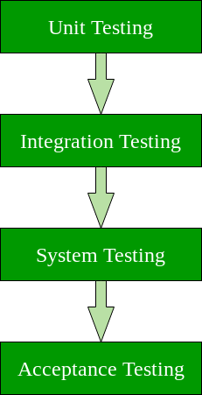
SOFTWARE TESTING FUNDAMENTALS

Slide 40
WHITE BOX TESTING
White box testing techniques analyze the internal structures the used data structures, internal design, code structure and the working of the software rather than just the functionality as in black box testing. It is also called glass box testing or clear box testing or structural testing.
Types of White Box Testing
Unit Testing: It is often the first type of testing done on an application. It is performed on each unit or block of code as it is developed. Unit Testing is essentially done by the programmer. As a software developer, you develop a few lines of code, a single function or an object and test it to make sure it works before continuing Unit Testing helps identify a majority of bugs, early in the software development lifecycle.
Bugs identified in this stage are cheaper and easy to fix.

Slide 41
WHITE BOX TESTING
Testing for Memory Leaks: Memory leaks are leading causes of slower running applications. A QA specialist who is experienced at detecting memory leaks is essential in cases where you have a slow running software application.
White Box Testing Tools
ParasoftJtest
EclEmma
NUnit
PyUnit
HTMLUnit
CppUnit

Slide 42
WHITE BOX TESTING
Advantages of White Box Testing
Code optimization by finding hidden errors.
White box tests cases can be easily automated.
Testing is more thorough as all code paths are usually covered.
Disadvantages of White Box Testing
White box testing can be quite complex and expensive.
Developers who usually execute white box test cases detest it. The white box testing by developers is not detailed can lead to production errors.
White box testing requires professional resources, with a detailed understanding of programming and implementation.
White-box testing is time-consuming, bigger programming applications take the time to test fully.

Slide 43
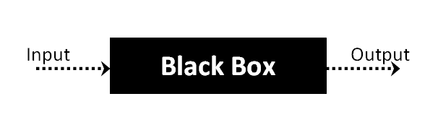
BLACK BOX TESTING
Black Box Testing is a software testing method in which the functionalities of software applications are tested without having knowledge of internal code structure, implementation details and internal paths.
Black Box Testing mainly focuses on input and output of software applications and it is entirely based on software requirements and specifications. It is also known as Behavioral Testing.

Slide 44
BLACK BOX TESTING
The generic steps followed to carry out any type of Black Box Testing.
Initially, the requirements and specifications of the system are examined.
Tester chooses valid inputs (positive test scenario) to check whether SUT processes them correctly. Also, some invalid inputs (negative test scenario) are chosen to verify that the SUT is able to detect them.
Tester determines expected outputs for all those inputs.
Software tester constructs test cases with the selected inputs.
The test cases are executed.
Software tester compares the actual outputs with the expected outputs.
Defects if any are fixed and re-tested.

Slide 45
BLACK BOX TESTING
Types of Black Box Testing
There are many types of Black Box Testing but the following are the prominent ones –
Functional testing – This black box testing type is related to the functional requirements of a system; it is done by software testers.
Non-functional testing – This type of black box testing is not related to testing of specific functionality, but non-functional requirements such as performance, scalability, usability.
Regression testing – Regression Testing is done after code fixes, upgrades or any other system maintenance to check the new code has not affected the existing code.

Slide 46
BLACK BOX TESTING
Tools used for Black Box Testing:
Tools used for Black box testing largely depends on the type of black box testing you are doing.
For Functional/ Regression Tests you can use – QTP, Selenium
For Non-Functional Tests, you can use – LoadRunner, Jmeter

Slide 47
BLACK BOX TESTING
Black Box Testing Techniques
Following are the prominent Test Strategy amongst the many used in Black box Testing
Equivalence Class Testing: It is used to minimize the number of possible test cases to an optimum level while maintains reasonable test coverage.
Boundary Value Testing: Boundary value testing is focused on the values at boundaries. This technique determines whether a certain range of values are acceptable by the system or not. It is very useful in reducing the number of test cases. It is most suitable for the systems where an input is within certain ranges.
Decision Table Testing: A decision table puts causes and their effects in a matrix. There is a unique combination in each column.

Slide 48
OBJECT ORIENTED TESTING METHOD
In object-oriented programs, control flow is characterized by message passing among objects, and the control flow switches from one object to another by inter-object communication. Consequently, there is no control flow within a class like functions.
This lack of sequential control flow within a class requires different approaches for testing. Furthermore, in a function, arguments passed to the function with global data determine the path of execution within the procedure.
But, in an object, the state associated with the object also influences the path of execution, and methods of a class can communicate among themselves through this state because this state is persistent across invocations of methods.
Hence, for testing objects, the state of an object has to play an important role.

Slide 49
OBJECT ORIENTED TESTING METHOD
Techniques of object-oriented testing are as follows:
Fault Based Testing:
This type of checking permits for coming up with test cases supported the consumer specification or the code or both. It tries to identify possible faults . For all of these faults, a test case is developed to “flush” the errors out. These tests also force each time of code to be executed.
This method of testing does not find all types of errors. However, incorrect specification and interface errors can be missed. These types of errors can be uncovered by function testing in the traditional testing model.
In the object-oriented model, interaction errors can be uncovered by scenario-based testing. This form of Object oriented-testing can only test against the client’s specifications, so interface errors are still missed.

Slide 50
OBJECT ORIENTED TESTING METHOD
Class Testing Based on Method Testing:
This approach is the simplest approach to test classes. Each method of the class performs a well defined cohesive function and can, therefore, be related to unit testing of the traditional testing techniques. Therefore all the methods of a class can be involved at least once to test the class.
Random Testing:
It is supported by developing a random test sequence that tries the minimum variety of operations typical to the behavior of the categories

Slide 51
OBJECT ORIENTED TESTING METHOD
Partition Testing:
This methodology categorizes the inputs and outputs of a category so as to check them severely. This minimizes the number of cases that have to be designed.
Scenario-based Testing:
It primarily involves capturing the user actions then stimulating them to similar actions throughout the test.
These tests tend to search out interaction form of error.

